Slide 1
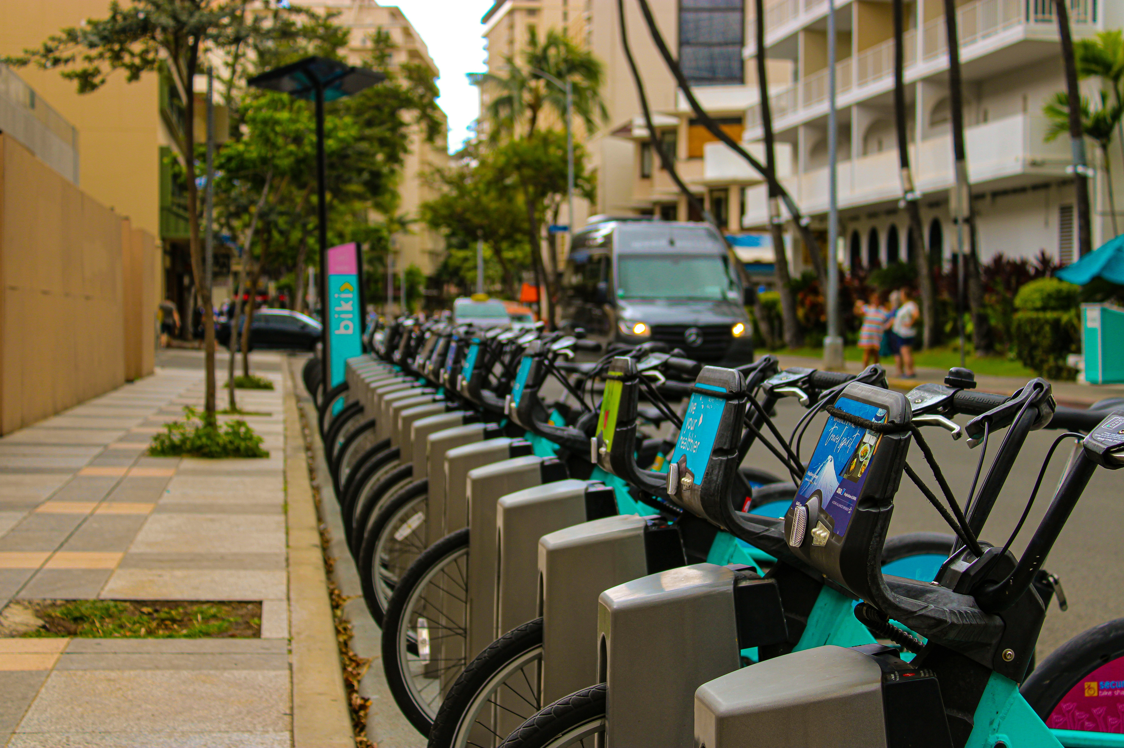
Unlocking Membership Growth
Presented by: Tosin Folorunso
Date Created: May 15, 2025

Slide 2
Table of Content
Unlocking Membership Growth
Purpose Statement
Present the Data Story
Conclusion
Appendix

Slide 3
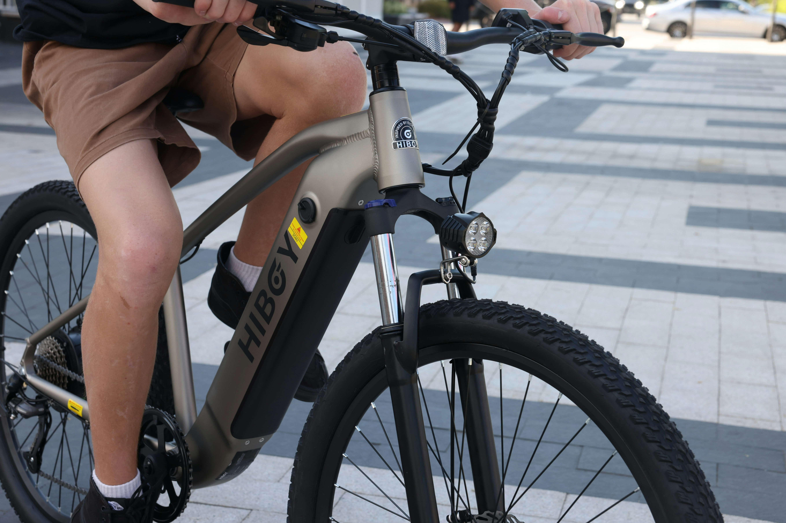
Purpose Statement
What are we talking about?

Slide 4
Objective
Analyze how casual riders and annual members differ in their riding behavior

Slide 5

Present the Data Story

Slide 6
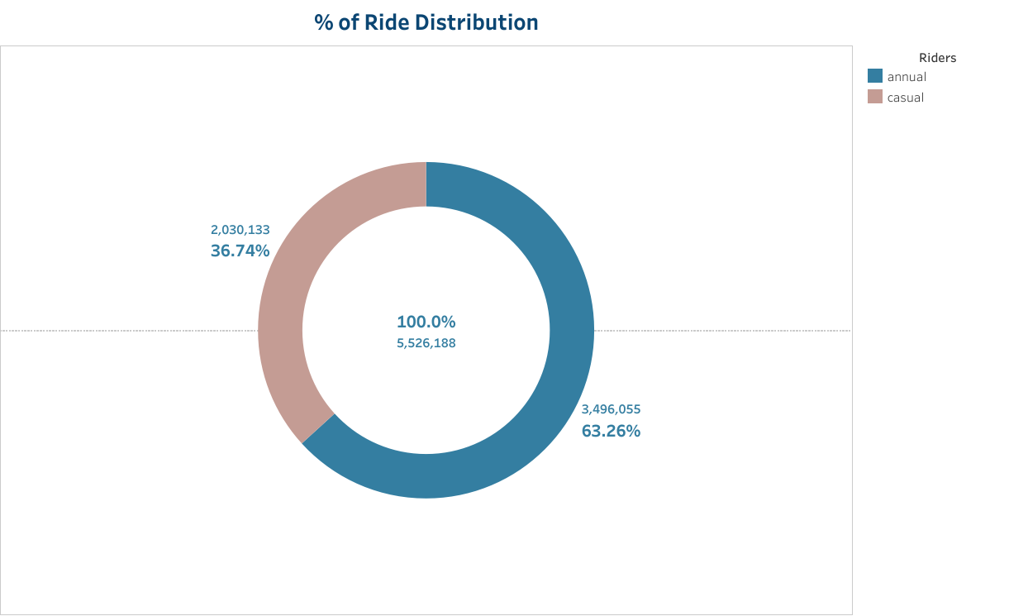
Ride Distribution
Annual members are the primary users of the service
However, casual riders represent a significant growth oppotunity

Slide 7
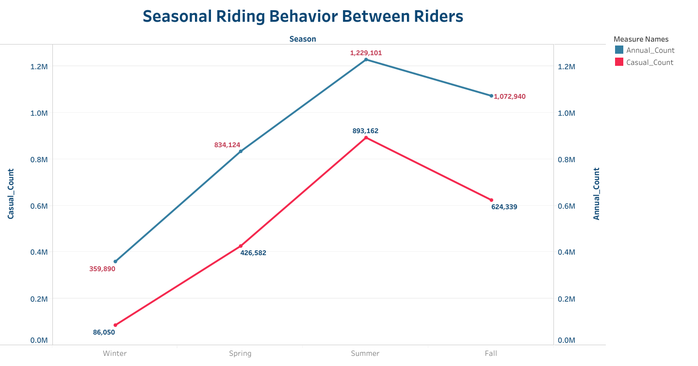
Seasonal Riding Pattern
Annual ridership is relatively stable
Casual riders fluctuate much more dramatically

Slide 8
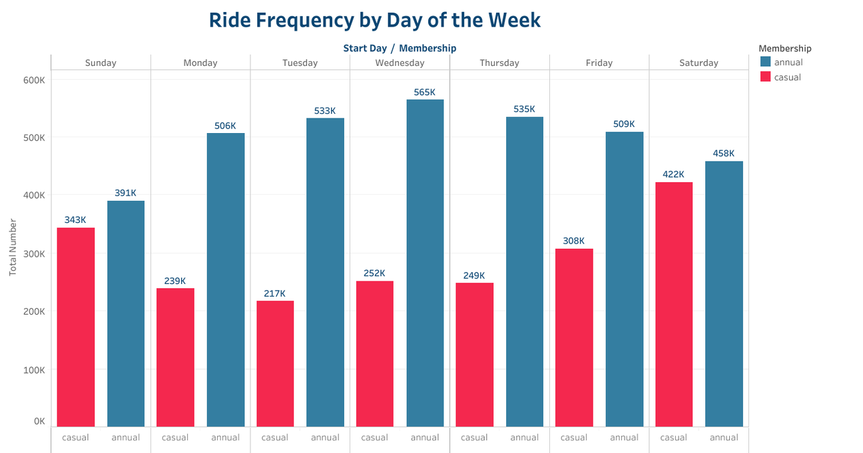
Daily Riding Pattern
Annual members use Cyclistic for commuting
Casual riders use Cyclistic for leasures and recreational activities

Slide 9
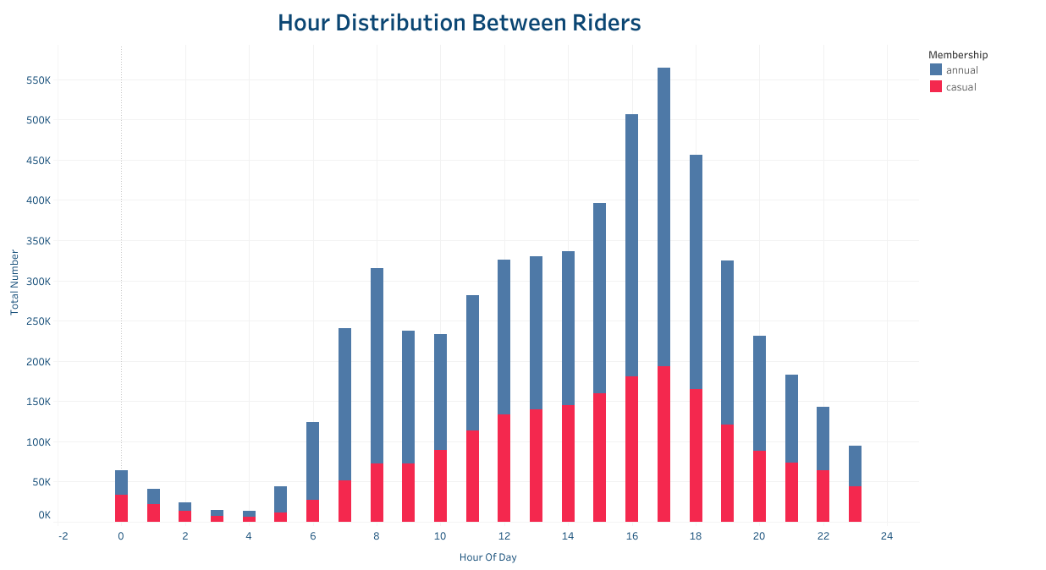
Hour of the Day Pattern
Annual members peak hours corresponds to commuting hours
Casual riders show a broader peak, starting later in the morning and extending to late afternoon

Slide 10
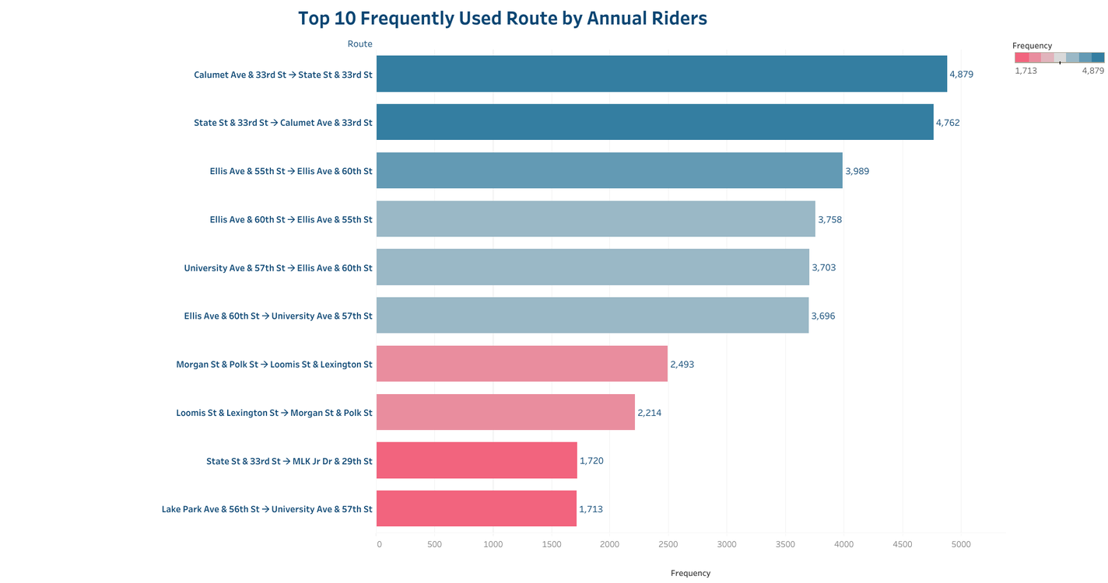
Frequently used route
Annual Members
Frequently used routes connect stations in business districts with nearby residential areas and transportation hubs.
Insights indicate that annual members use these routes for their daily commutes

Slide 11
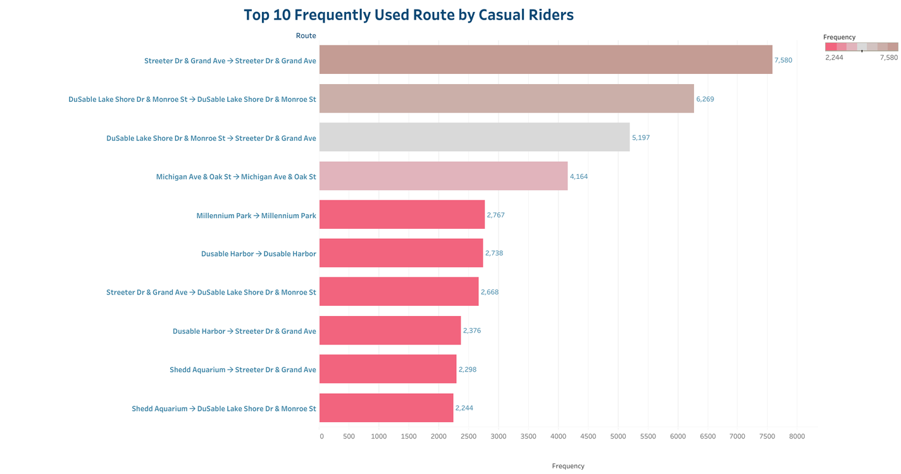
Frequently used route
Casual Members
Routes are concentrated around leisure and tourist destinations
Insight indicates that casual members use the bike-sharing service to explore the city

Slide 12
Conclusion

Slide 13
Conclusions
1
2
3
Annual members primarily use Cyclistic for daily commuting and essential transportation
Casual riders mainly use Cyclistic for leisure, recreation, and tourism
The distinct riding patterns suggest that annual members prioritize efficiency and convenience while casual riders prioritize enjoyment and exploration
Thus, having higher average ride duration

Slide 14
Thank You!!

